Slide 1


Team 2
Caring From Within - 2:30PM

Slide 2

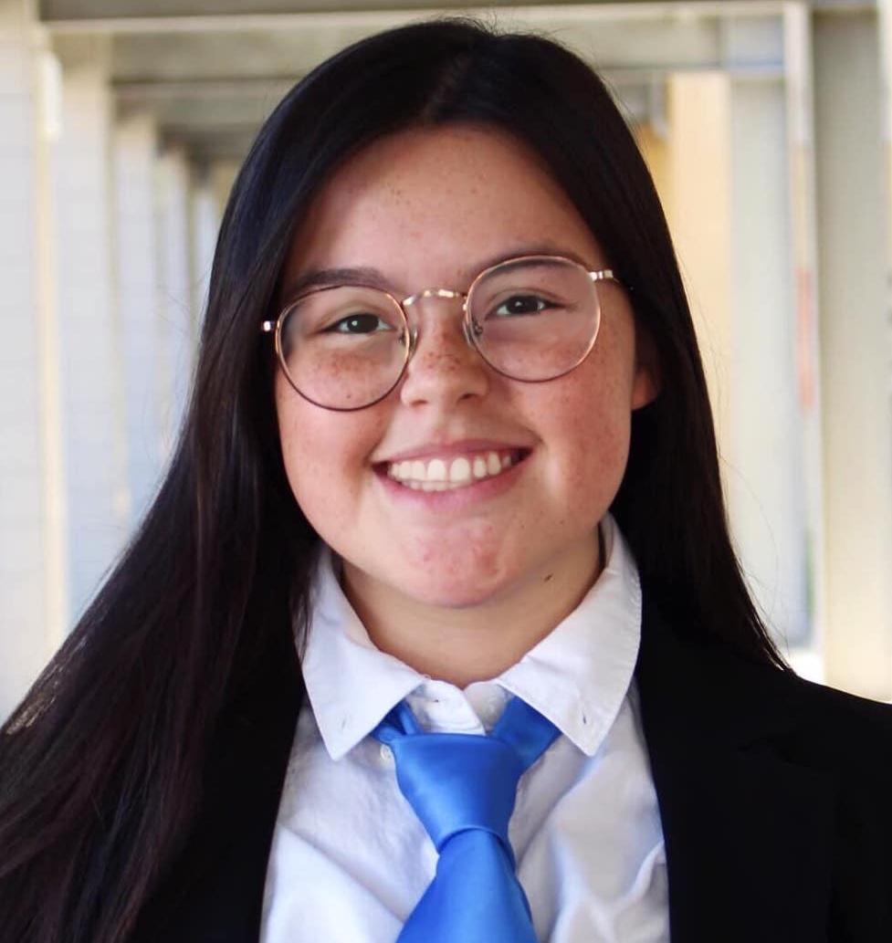

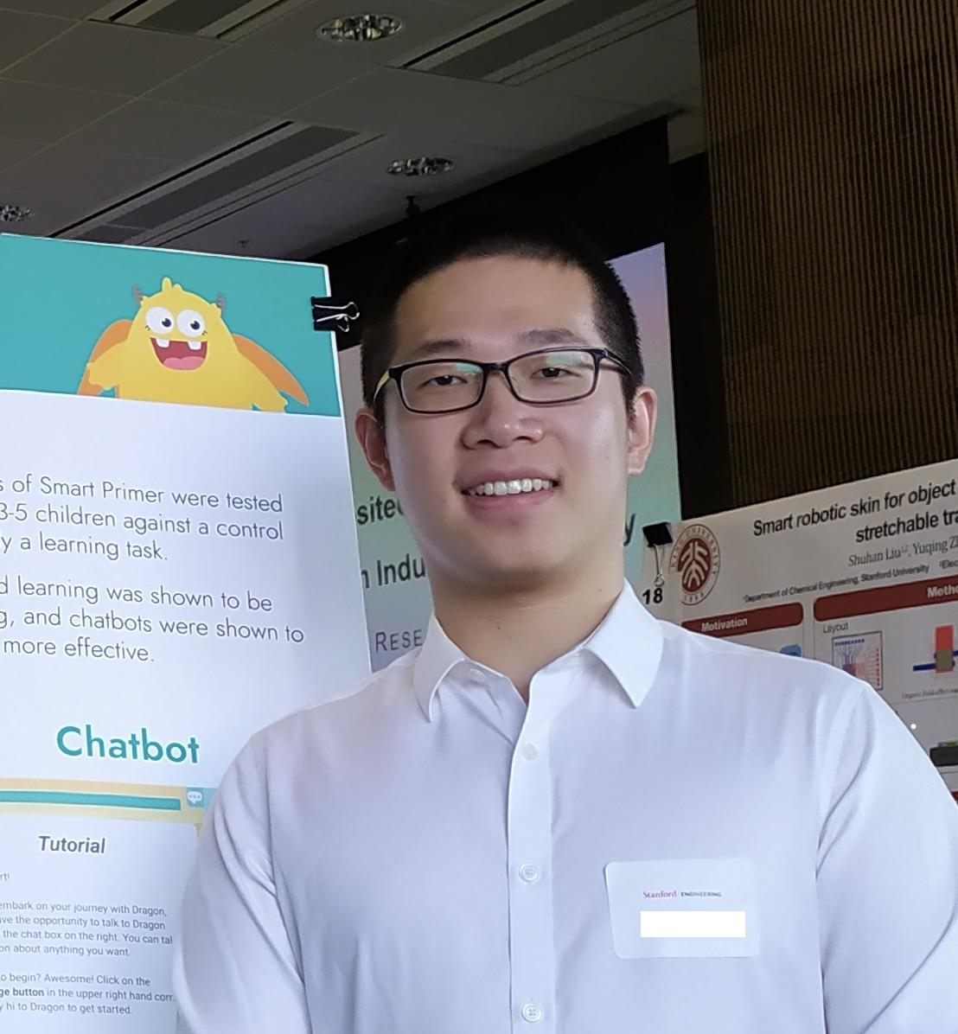
Our Team
Meng G.
UX Researcher
M.S. Symbolic Systems, C/O ‘23
Catherine H.
Product Manager
B.S. Computer Science (HCI),
C/O ‘23
Dyllen N.
Product Designer
B.S. Human-Centered Design and Engineering,
C/O ‘24
Rui Y.
Software Engineer
M.S. Computer Science (HCI), C/ O ‘23

Slide 3
Overview
1
Interface Designs & Rationale
2
Low-Fi Prototype
3
Task Flows
4
User Test
Method & Results

Slide 4
Additional
Needfinding
Interface Designs & Rationale

Slide 5
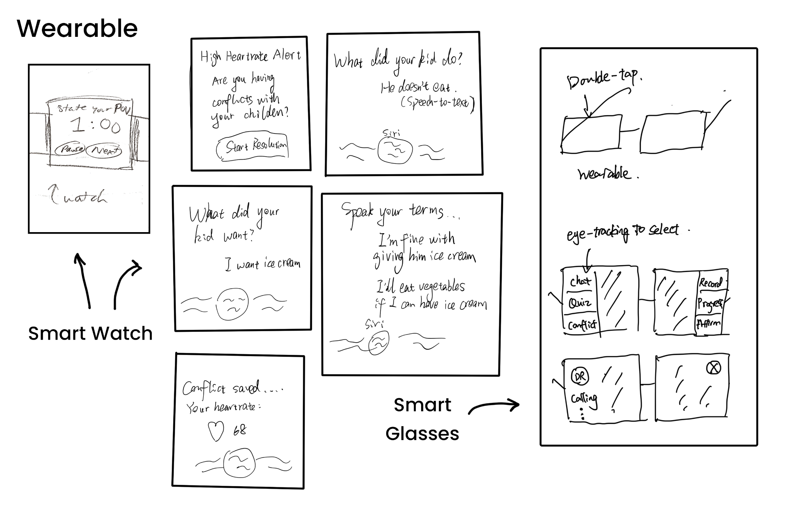
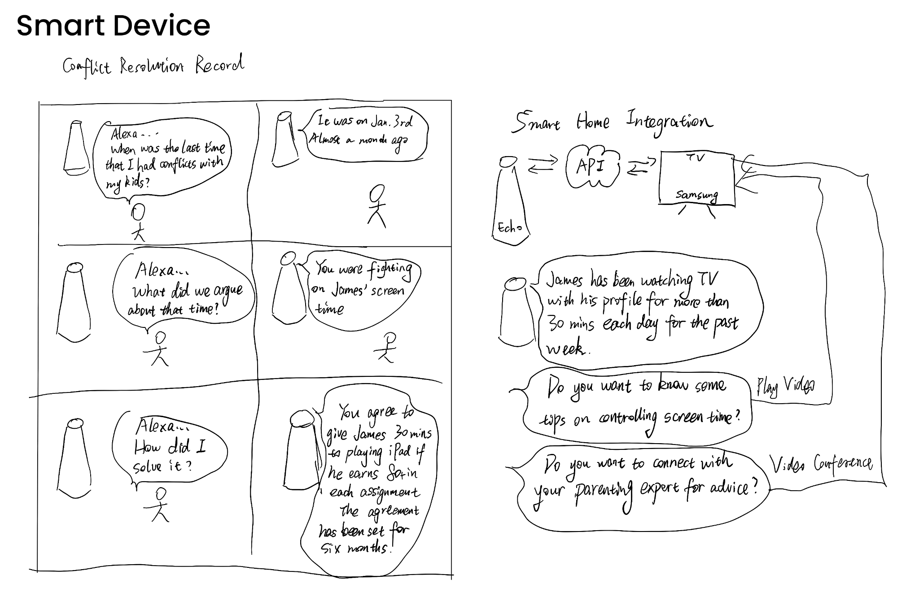
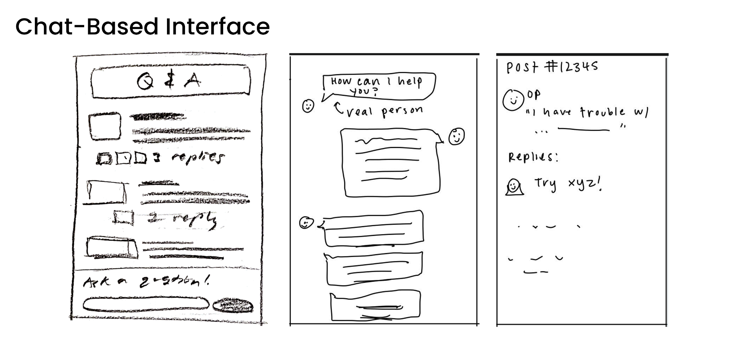
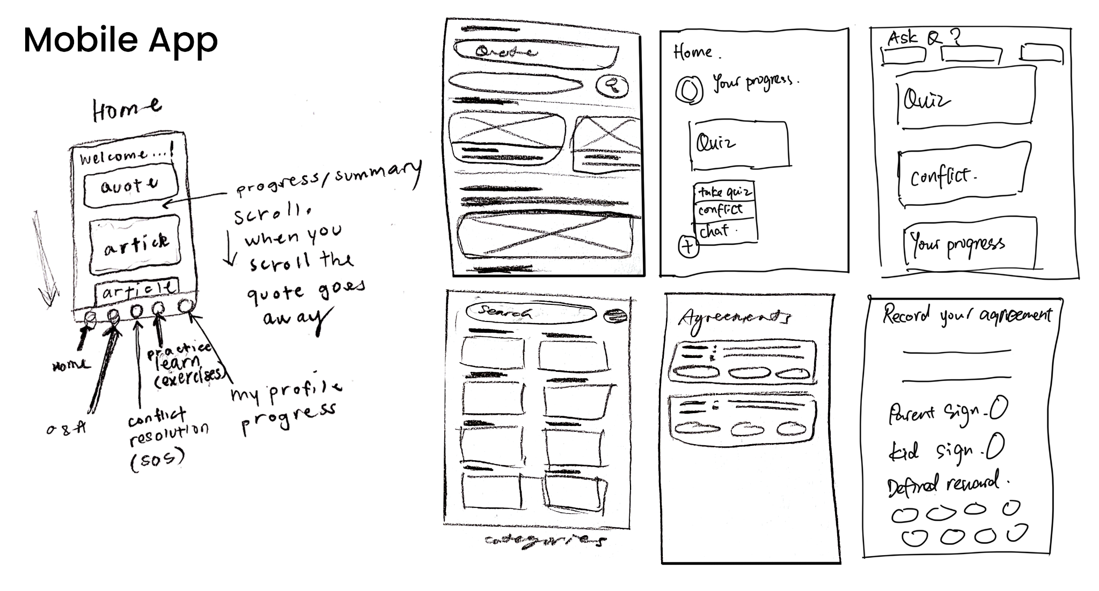
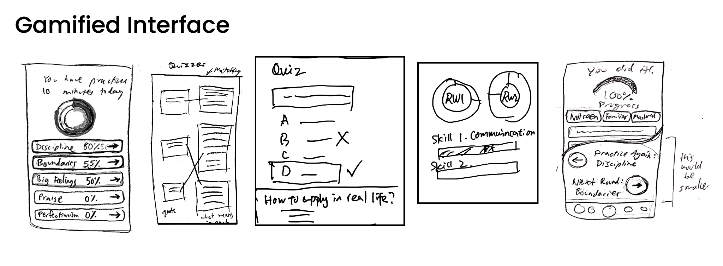
Interface Designs

Slide 6
Mobile App Interface
& Rationale
1
Broad platforms
Cover a large user base
2
Easy accessibility
Users are used to mobile apps
3
Various smartphone functionalities
Microphone/Camera/Push Notifications
4
Multiple features in one place
Easy to incorporate features in an organized way

Slide 7
Additional
Needfinding
Low-Fi Prototype

Slide 8
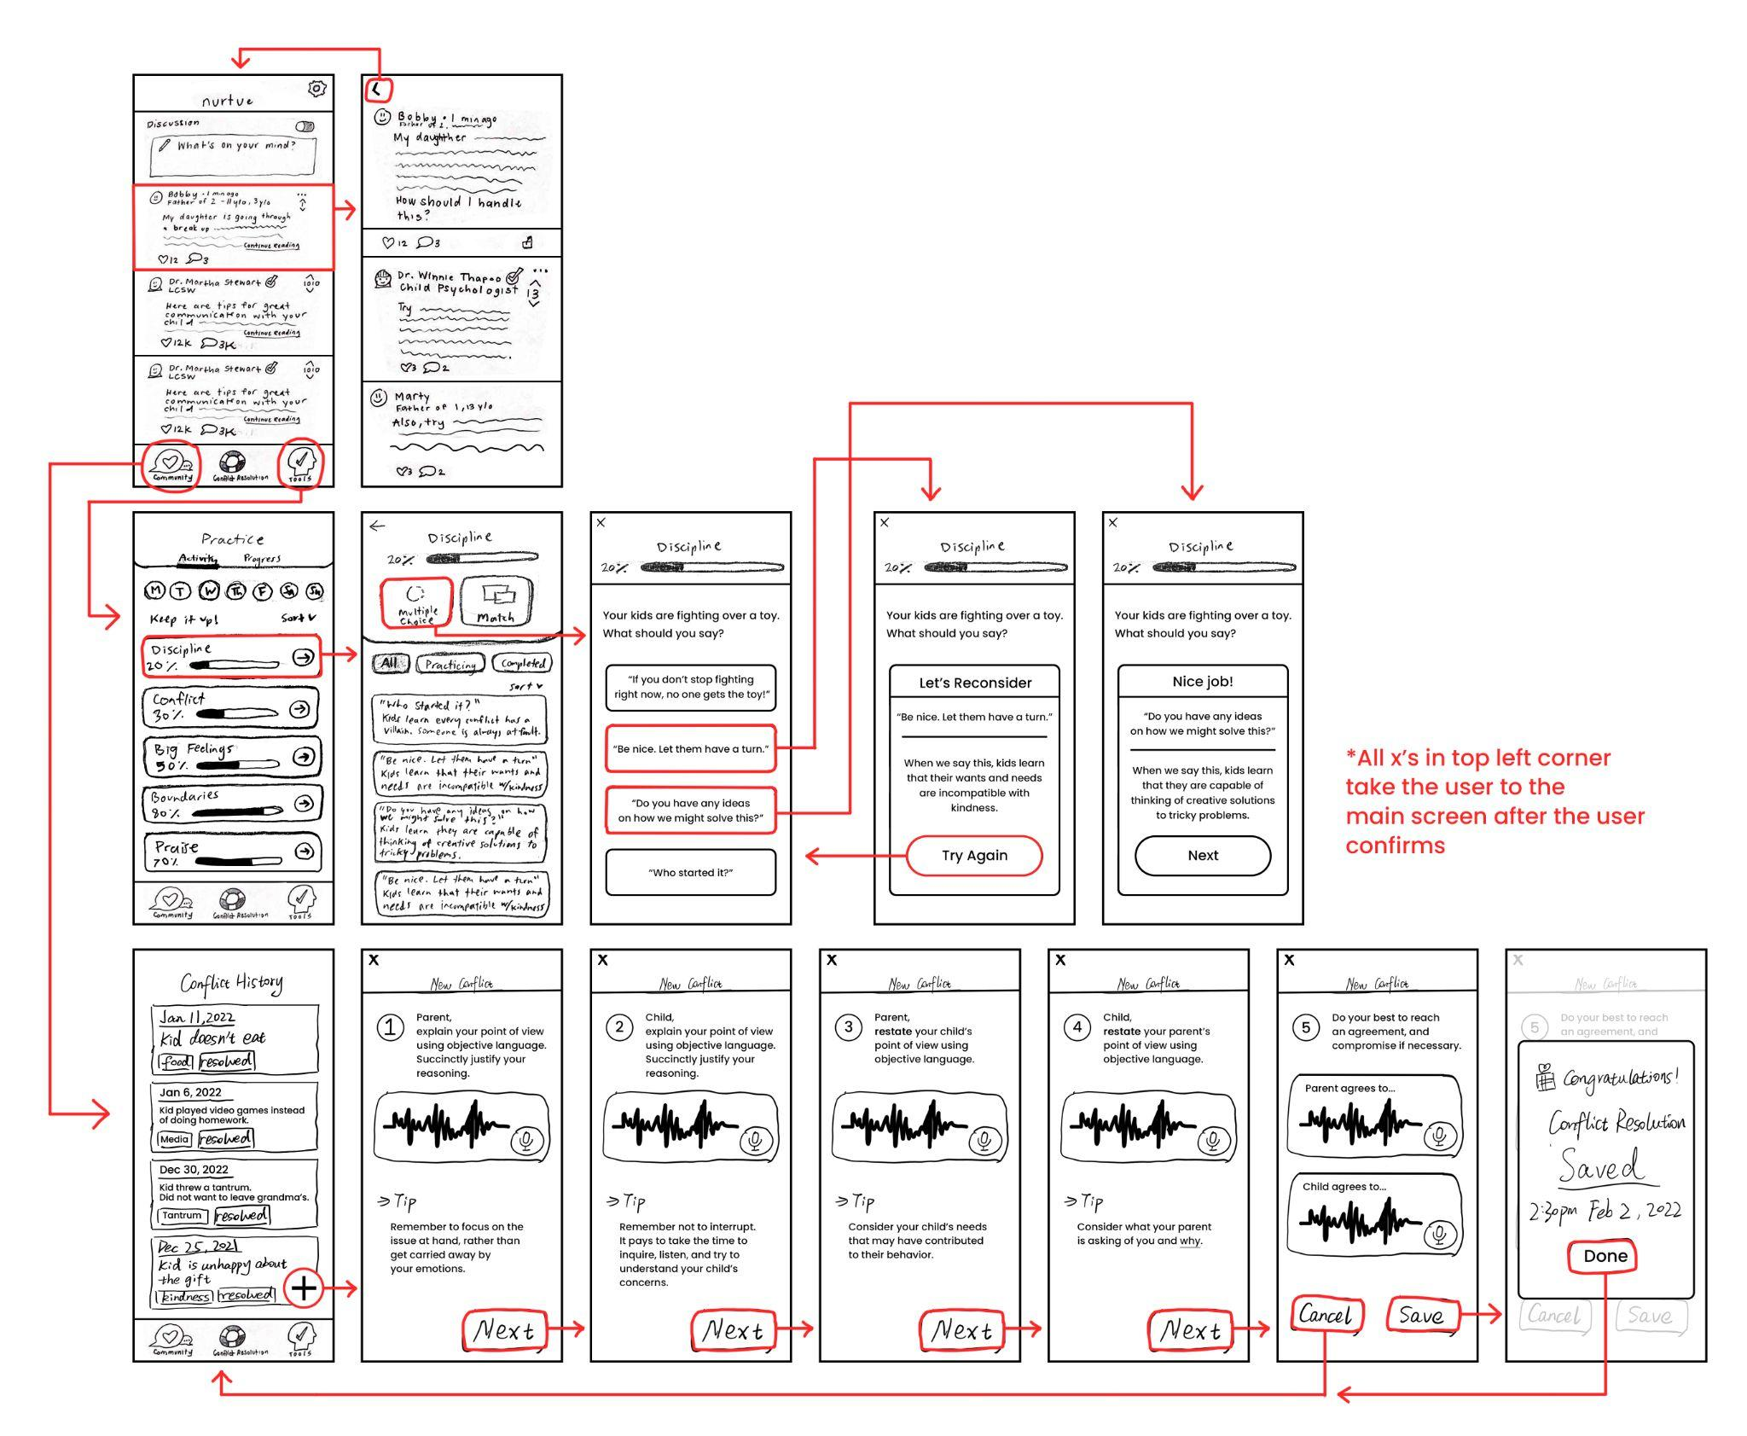
Low-Fi Prototype Structure

Slide 9
Additional
Needfinding
Task Flows

Slide 10
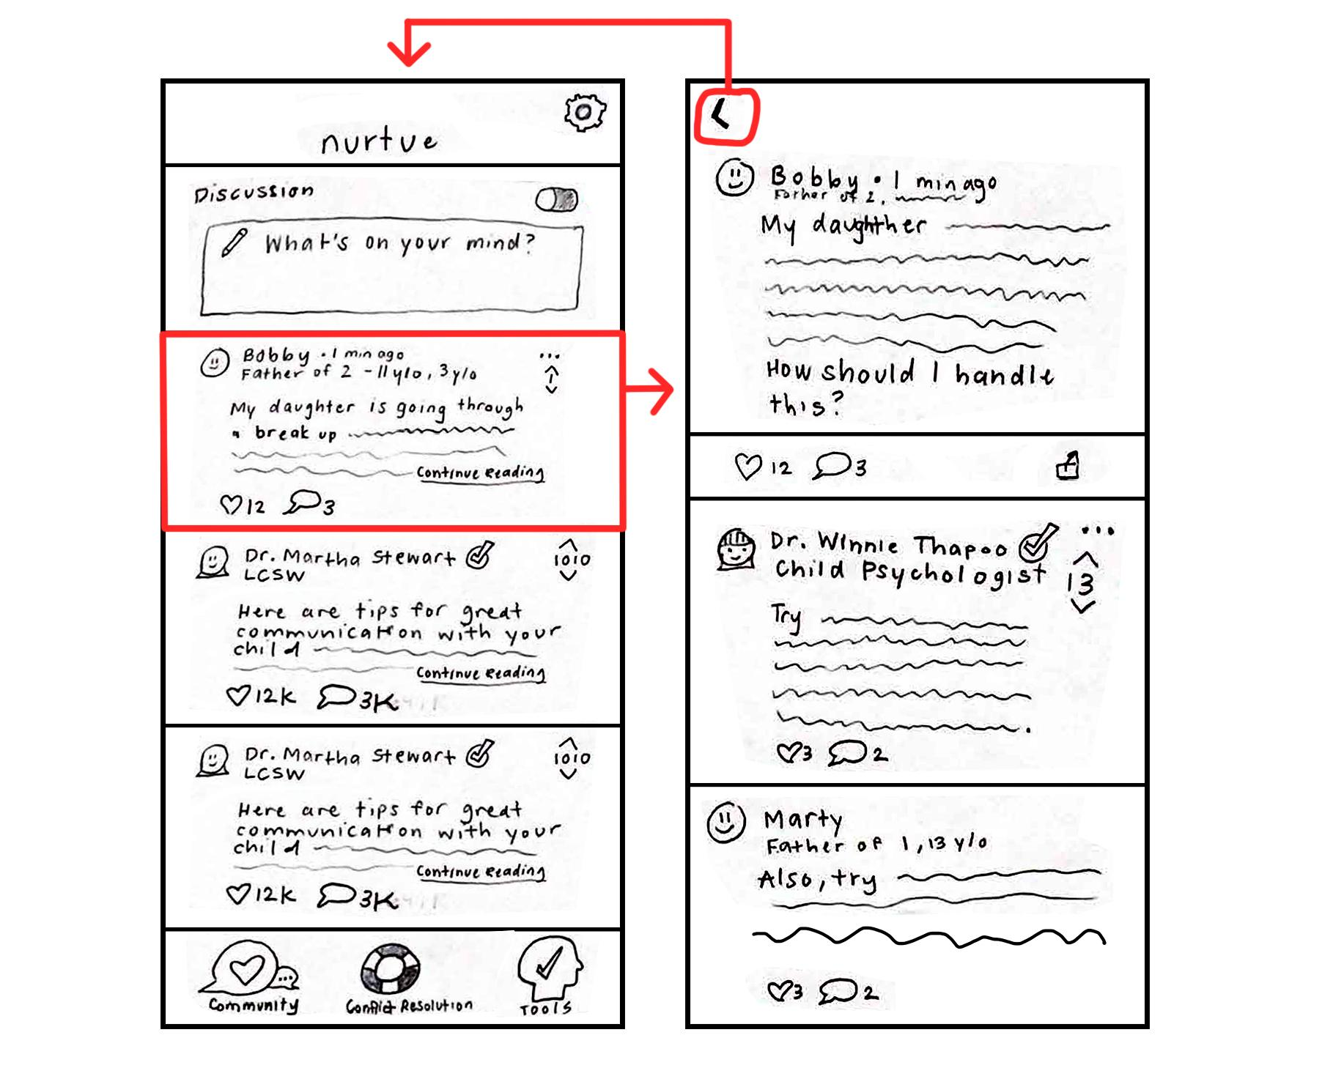
Task 1
Simple
Share your parenting struggles to get advice from fellow parents or/and experts in the field.

Slide 11
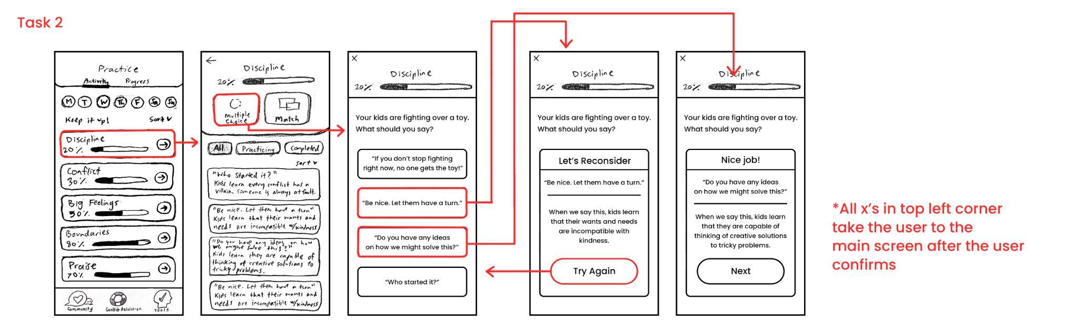
Task 2
Moderate
Practice more effective language to communicate with your child through interactive modules.

Slide 12
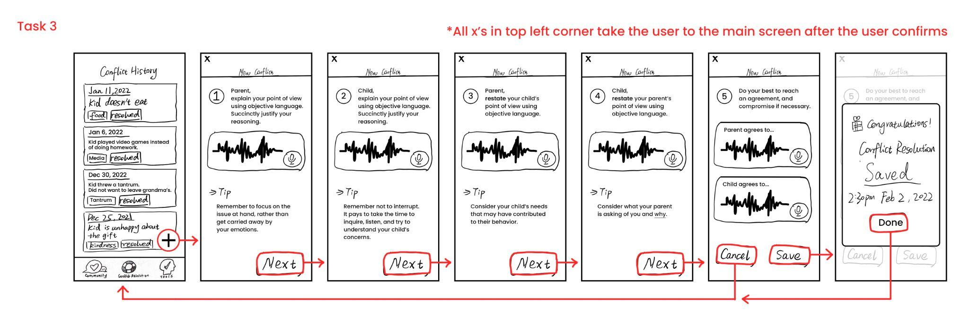
Task 3
Complex
Resolve a particular conflict with a child in a peaceful manner, and come to an agreement that the parent can reference.

Slide 13
Additional
Needfinding
User Tests

Slide 14
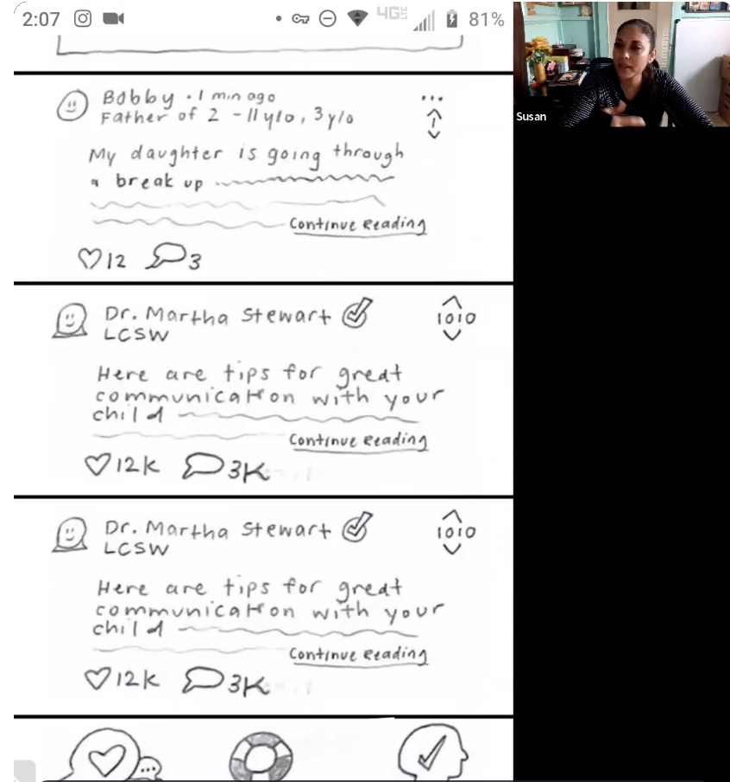

Test Method
1
Platform
Marvel POP
2
Means
Screen sharing via Zoom on mobile devices
3
Participants
Recruited from parent mailing lists
#1 Susan
Hispanic mom
Realtor
9 y/o boy
San Diego
#2 Dan
Asian dad
Self-employed
11 y/o boy
Fremont
#3 Lijia
Asian mom
High school teacher
10 y/o girl, 7 y/o boy
Boston

Slide 15
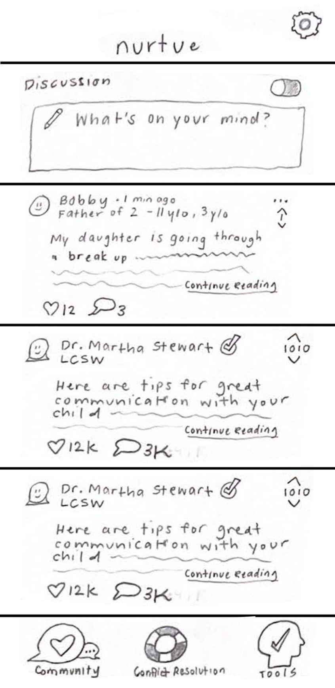
Result
Positive
Participants found the community tab comforting and useful
“I like that it displays the child's age. It’ll be helpful to get more relevant information about my situation.”
“I like it. Looks like a basic social media platform to engage with parents and experts.”
“It’s simple and intuitive to use.”
Participants wished:
To filter the posts pertain to their specific situation, their children’s age groups, or their children’s gender;
For non-native English speakers, reduce the amount of texts to read on the main community tab.

Slide 16
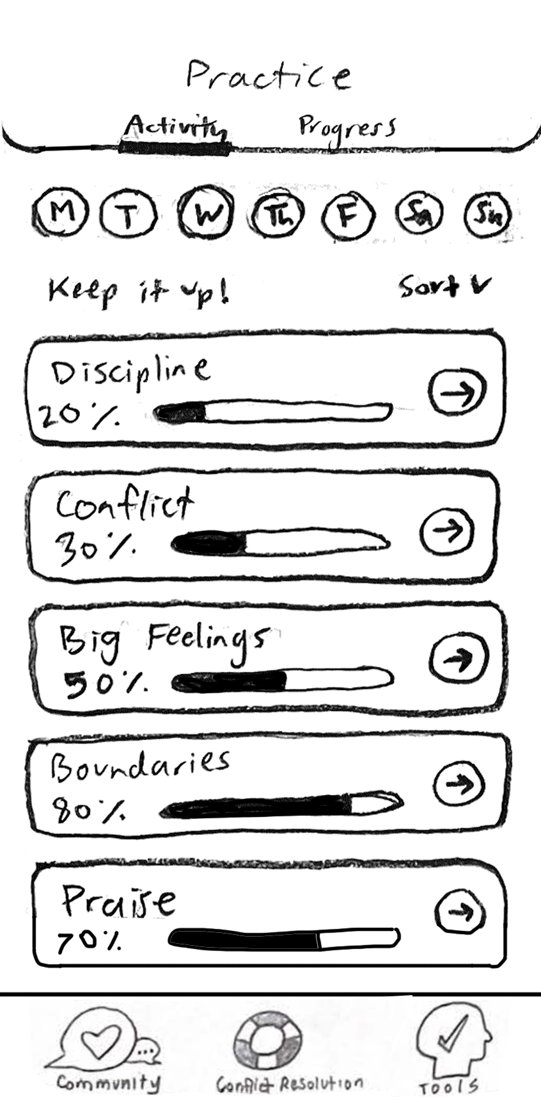
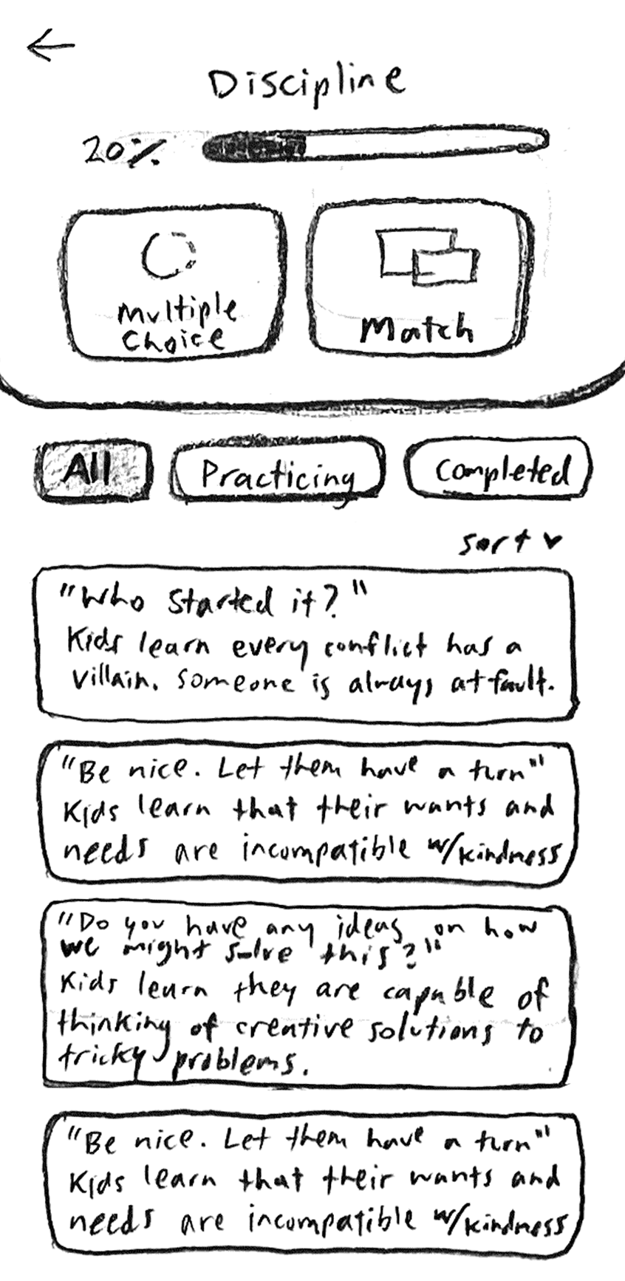
Result
Negative
Participants had trouble navigating to the practice exercises
Participants wondered:
What “tools” means and how it can help them;
What can keep busy parents motivated to practice these skills;
How can we build the credibility of answers since there is no absolute right or wrong answers in parenting.
Error 2:
Participants’ eyes landed on the educational content itself rather than the buttons above to start practicing
Error 1: “Tools” labeling

Slide 17
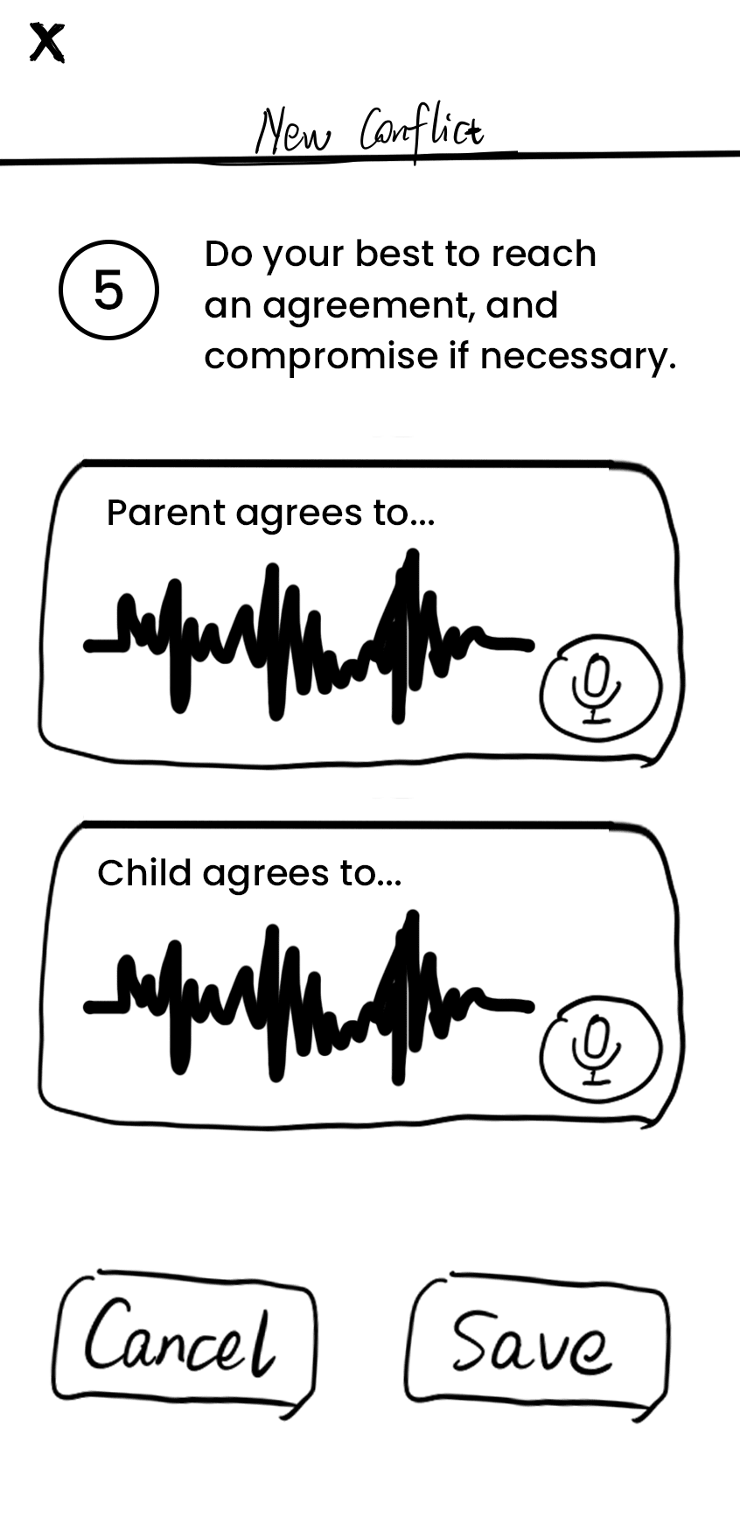
Result
Positive
Participants enjoyed the conflict resolution concept and emphasized following through on an agreement
“I record my kid’s agreement using my phone sometimes to avoid recurring conflicts. This feature can help me organize the agreements.”
“This could be a cooling down process when you are really angry with your child.”
“I like that both parents and kids can get the chance to talk.”
Participants wished:
To add more statues for conflicts (resolved/partially resolved/still working on it) because it took time to solve conflicts;
To have a timer for both parties to help them stay focused on solving the problem.

Slide 18
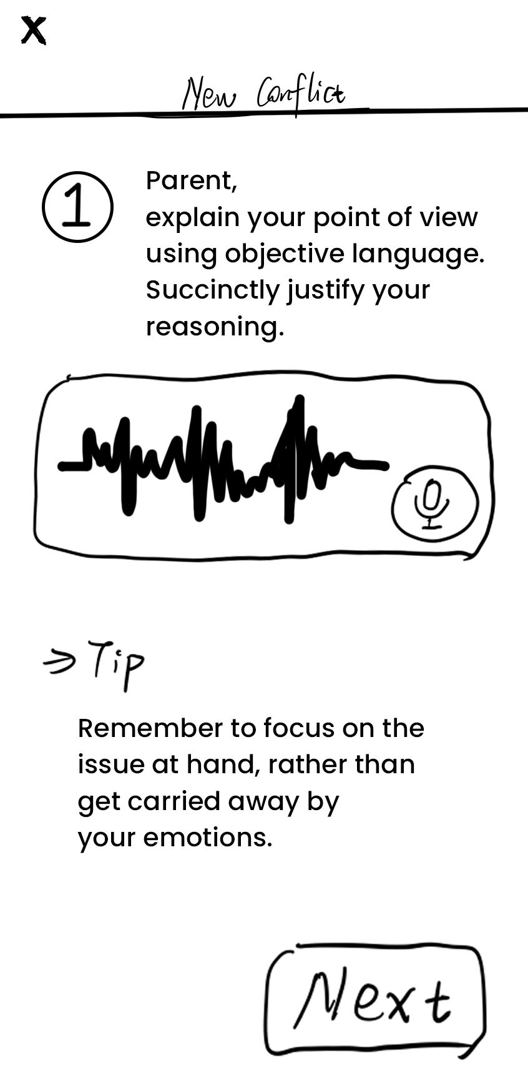
Result
Negative
Participants didn’t know what to do in the conflict resolution steps
Participants totally ignored the input area
Participants wondered:
If there can be more input options, such as typing or auto transcribing;
If some of the steps can be simplified.
“Didn't know if it means that you need to have conversations with children or that you can record audio.”
“I have to go through many steps.”

Slide 19
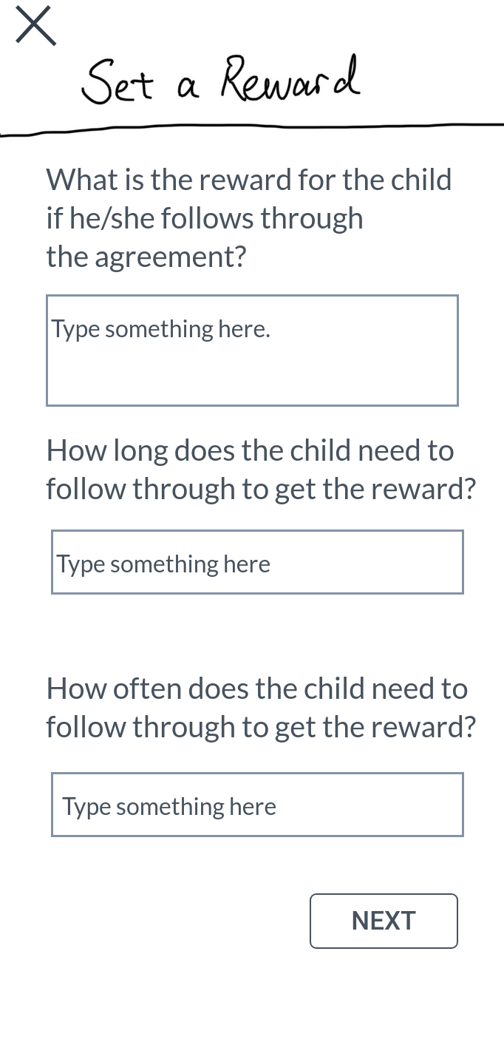
Result
Negative
Participants were confused about setting a reward for conflict resolution
“You shouldn’t reward them for what they should have done.”
Participants wondered:
How to set the “right” reward for children;
What if the conflict couldn’t be resolved and what if the agreement was broken.
“It’s similar to the last step (of reaching an agreement).”

Slide 20


Suggested UI Changes
Community Tab
Every post will be titled, and only the user information and the title of the post would appear on the front page.
Search and filter icon at the top of the posts so users can specify the type of content they are looking for.
Add a welcome greeting and affirmation to top of home screen.
Remove the text input box and add a plus button in the bottom right corner to avoid the clutter of UI elements.
Welcome :)
+

Slide 21
Suggested UI Changes
Practice Tab
Rename “Tools” to “Practice” so the navigation is more intuitive.
Simplify the game screen. It will briefly explain the game and have one button to start.
Include sources/citations within the game itself so users feel that they can trust the information.
Sources:
Stanford research…
Practice

Slide 22
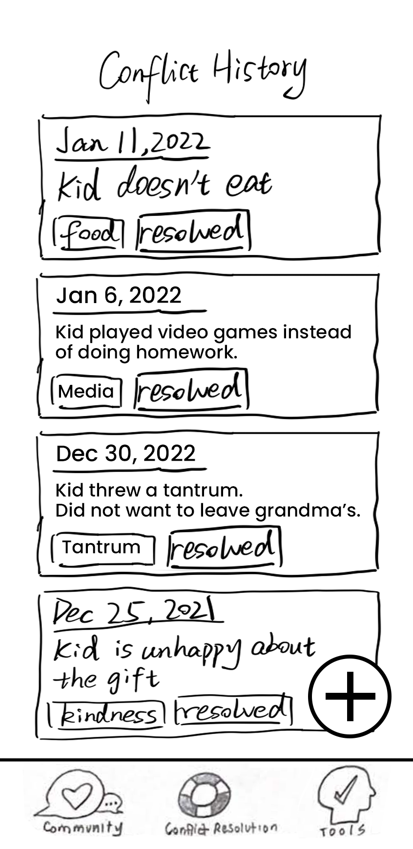
Suggested UI Changes
Conflict Resolution Tab
Change “Conflict History” to “History” and showcase the agreements instead of conflicts.
Only the agreement screen will allow the option to voice record or input text. No recording on the other stages of conflict resolution.
Add a timer within each stage of the exercise to keep users on task. It will be set to a default time that users can change in the settings.
Remove the rigid reward system because it depends on the severity of the conflict. Users will instead be prompted to consider including rewards or punishments when they record their agreement.
Agreement #1
Agreement #2

Slide 23
Additional
Needfinding
Summary

Slide 24
Summary
Use space and proximity in design.
1
2
Keep UI straightforward.
Avoid clutter.
Mobile App interface allows more accessibility & features.
User feedback is key for design improvements.
4
3

Slide 25
Additional
Needfinding
Q&A

